Slide 1
Use of Waste Walk
Try the GEMBA waste walk in your organization and see how many of the 8 types of waste you can identify
Tips
Involve participants outside of the process
Involve participants who do the process every day
Create your own form that’s customized to your environment & includes the DOWNTIME checklist
Properly train individuals participating in Lean – focus on GEMBA in particular
Identify the goal of the session and commit to acting on the outcome
Communicate the event to all process participants and stakeholders in advance
Share results over time with participants as well as process owners and stakeholders

Slide 2
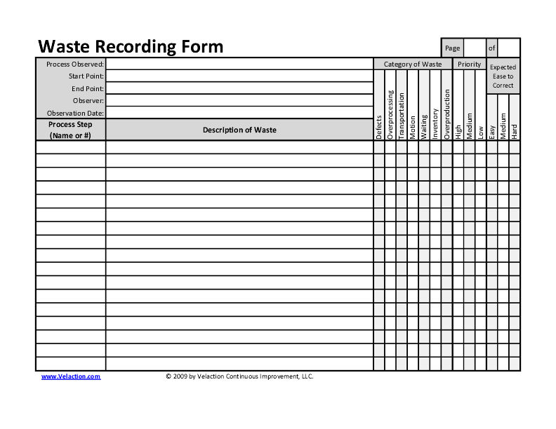

Slide 3
Tips from Franciscan St Francis Health

